Slide 1
Measures Taken on Management Level: Comparing actual versus target
Towards a Sustainable Agro-Food Industry. Capacity Building Programmes in Energy Efficiency.
This project has received funding from the European Union’s H2020 Coordination Support Action under Grant Agreement No.785047.

Slide 2
Wrap up: Overall GAP Analysis from Stage 1 (Example)
Topic | Identified GAP in Stage 1 | Measures from Stage 1 | Due date | Resources allocated
Context analysis | There is no overview over influences on energy performance from outside the company | Perform a context analysis until | 3rd of September 2019 | Energy Manager, Legal Department (Workshop)
Stakeholder | There is no map of Stakeholders inside and outside the company with their interests | Marketing shall identify and analyse relevant stakeholders | 5th of October 2019 | Purchasement, Energy Manager (Workshop
Risks and opportunities
Allocation of roles
Training
Communication
…

Slide 3
Wrap up: Integration in Strategic Management Processes
Input
Planning
Results
Strategic Planning
Management
Context & stakeholder analysis
Risk & Opportunities
Determination
Identifying measures from Opportunities & Risks
Tactical Planning
Energy
Team
Energetic evaluation
Determination of the SEU incl.
relevant variables
energy-related performance
relevant staff
Prioritisation of efficiency measures
Evaluation of energy use & consumption
consumption prognosis
efficiency measures
Main consumer (SEU)
key figures
Energy targets
Energy data collection plan
Energy source
Energy input
Energy consumers
Quelle: Eigene Darstellung basierend auf DIN ISO 50001:2018, Bild A.2

Slide 4
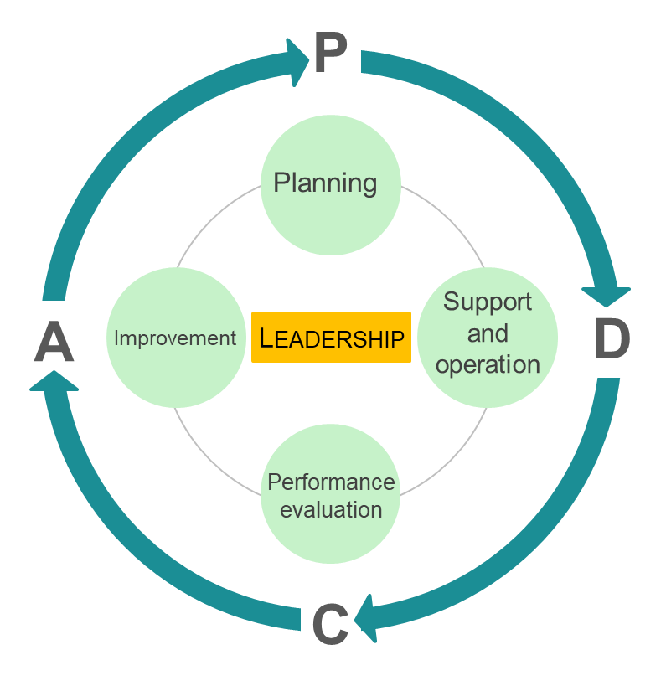
Integration in Strategic Management Processes
Inputs for planning
Context and Stakeholder Analysis
Determine internal & external topics that have an influence on the EnMS and the energy related performances (environment / context analysis)
Determine interested parties with influence on energy related performances and EnMS
Determine relevant requirements and expectations of the parties and how to deal with the points identified
Expected Documentation
Context analysis
Stakeholder analysis (topics, parties, requirements), possibly as part of the context analysis
Context of the organization
Scope of the energy management system
Internal and external issues
Needs and expectations of interested parties

Intended outcomes of the energy management system
Notes:
Describe new requirements of Chapters (4.1, 4.2,)
Explain new vocabulary
Explain actual Doing:
Identify relevant topics regarding EnMS/ ebL , e.g. technical Innovations, new Customer requirements, legal changes, etc.
Use PESTEL-Analysis (Political, economic, social, technical, ecological, legal)
Afterwards check for stakeholders.
Check if Integration in exisiting IMS is possible, as Stakeholderanalysis is frequently done in other man. systems.

Slide 5
Integration in Strategic Management Processes
Which drivers of Energy Management were identified?
Context Analysis Example
Political Drivers
Economical Drivers
Sociales Drivers
2° degree target
Climate protection at German and European level
NAPE
Changes in tax policy
Corporate policy
Business policy
Energy price development
Commodity prices
Tax refund (SpAefV)
Energy saving
Sales growth / production capacity utilization
Subsidies (state, country)
Resources for EnM
Education and training Employees Energy efficiency
Employee participation regarding energy in the company
Responsibility in the region
Technical Drivers
Legal Drivers
Ecological Drivers
Energy Technology Development
Sector coupling
Storage technologies
Renewable Energies
E-Mobility
Digitization Infrastructure, software, GLT,...
Compliance with all legal requirements (e.g. StromStG, EnergieStG, EEG)
ETS
Audit/reporting obligation
CSR
ISO 50001/16247-1
Environmental Constraints
Exhaust Emissions
Water consumption
Energetic building modernisation (e.g. thermal insulation)
Requirements of customers with regard to CO2
Green electricity
Notes:
If time is abundant you can do brainstorm with Top Management regarding Context and Stakeholders,
otherwise show and explain selected examples from Table above

Slide 6
Integration in Strategic Management Processes
Stockholder Analysis Example
Which stakeholders where identified and what Interests do they have?
Examples of Interested Parties | Interests
Capital providers/investors | High return on Investment
Corporate management | Adherence to corporate goals
Controlling | Securing energy tax effects
Employees | Innovative & safe workplace
Lawmakers | Compliance with energy legislation
The public | Energy-saving production
Climate Partnership | Compliance with climate targets
Clients | Prices/Availability
Notes:
See above

Slide 7
Wrap up: Integration in Strategic Management Processes
Input
Planning
Results
Strategic Planning
Management
Context & stakeholder analysis
Risk & Opportunities
Determination
Identifying measures from Opportunities & Risks
Tactical Planning
Energy
Team
Energetic evaluation
Determination of the SEU incl.
relevant variables
energy-related performance
relevant staff
Prioritisation of efficiency measures
Evaluation of energy use & consumption
consumption prognosis
efficiency measures
Main consumer (SEU)
key figures
Energy targets
Energy data collection plan
Energy source
Energy input
Energy consumers

Slide 8
Integration in Strategic Management Processes
Planning Process
Risk and Opportunity Analysis
Determination of opportunities and risks for Energy Related Performances and EnMS
Define measures for dealing with opportunities and risks
Evaluate the effectiveness of the measures
Expected Documentation
Opportunities and risk analysis (if necessary within the context of context analysis)
Measures for dealing with opportunities and risks (if necessary in action plans, corrective and preventive action plans or EnMS action plans)

Which risks and opportunities were identified and which measures were taken?

Slide 9
Integration in Strategic Management Processes
Risk & Opportunity Determination - Examples
 | Stakeholder | Requirements | Relevance (1-5) | Control / Application points | Risk / Opportunity
1 | Purchasing / Controlling | Stability / Reduction of energy costs | 4 | Investments in green technologies and processes with subsidies | Opportunity
2 | Employees | Attractive Employer Resources and Training / further education concerning Influence on energy efficiency | 3 | Resource Management Training and motivation concept for energy efficiency | Opportunity
3 | Management | EEG exemption, tax refund Image | 5 | Implementation of the EnM / ISO 50001 with the necessary resources | Opportunity
4 | Clients | Requirements Precise data on CO₂ values Products Climate protection | 4 | CO₂ certificate products, measurement, Reporting | Risk
5 | Politics / Legislation | Compliance with energy and climate targets for companies (Germany / EU) | 5 | Introduction of operation ISO 50001 and/or execution of energy audits according to EDL-G compliance compliance | Risk
Which Application points were identified?
Notes:
One possibility of Rating of risk and rewards (simple relevance assessment)

Slide 10
Integration in Strategic Management Processes
Measures to adress Risk & Opportunities – Examples (2/2)
 | Risk / Opportunity | Source | Cause | Assessment Risk | Assessment Opportunity | Measures | Prio-rity
1 | Non-compliance with obligations | Lawmakers | Laws and deadlines are forgotten | 5 |  | Continuous updating of legal cadastre, adherence to delivery deadlines through cooperation with news service | 5
2 | Energy price/ CO₂ reduction | Technology EnMS | Potential to refine overcapacities from wind energy (sector coupling) |  | 4 | Concept and efficiency audit Conversion of hydrogen production (natural gas) to electricity via electrolysis. | 3
3 | Employees time | EnMS | Resources required to achieve energy goals and obtain certificate | 3 |  | Execution of resource audit to plan the necessary and necessary steps up to certification. | 2
4 | Employees skills | EnMS | Training new employees in the company. |  | 3 | Training for plant managers and weekly posting of energy consumption & key figures. | 3
5 | Water availability Corporate image in the region | Water supply | High water consumption for steam generation. Water scarcity in summer months. | 4 |  | Creation of alternative energy concepts | 4
Which risks and opportunities were identified and which measures were defined?
Corrective Action needed?
Notes:
More advanced approach with risk assessment.

Slide 11
Integration in Strategic Management Processes
Result: Identification and definition of objectives
Which Targets where defined to improve the Management system?
Results
Target system
Targets to improve the Energy Mangement System
Energy Targets
Management
Identification of measures from opportunities & risks
Evaluation of energy use & consumption
consumption prognosis
efficiency measures
Main consumer (SEU)
key figures
Energy targets
Energy data collection plan
Energy
Team
Notes:
Final step: take actions of risk and reward assessment into account when defining goals.
Exlpain , that next to energy targets also management target are required which can be easily obtained from risk analysis

Slide 12
Responsibility Top Management
Changed Organizational Structure
Focus on energy management as a team
Identification of competence requirements and communication
How was Energy Team structure optimised?
How is it documented and how is it enforced?
How did Stage 1 employee trainings influence this?
Notes:
Second Main Focus is spreading responsibility in corporation.
Requirement is guarantee of abiltiy and communication

Slide 13
Identification of competence and communication
How can we reach
that colleagues and employees
Behavioural competence
Technical
competence
experiences
Personality
Want
Can
Motivation achievement
May

Slide 14
Which approaches were applied and how?
Approaches and Examples
Motivate
Feedback
Participate
Suggestion system
Energy Scouts
Inform
Contents
Meetings
Working groups
ProNak
Target agreement
Incentive systems
Benchmark
Contests
Energy Days
Media
Materials
Notices
Enable
Win
Protect
Service
E-Learning
Checklists specialist areas
Knowledge
Error culture
Check lists
Automate
PDCA
Coaching
Corporate culture
Change Management
Models
Stories
Rituals, Continuity
Advanced training

Slide 15
Documentation of further and corrective Actions

Slide 16
Overall Corrective and Further Actions (Example)
Define corrective actions where necessary
Topic | Measures planned in Stage 1 | Status of realisation | Corrective measure | Due date | Resources
Context analysis | Perform a context analysis until | Realised in September 2019 | None needed | None needed | None needed
Stakeholder | Purchasing Department shall identify relevant stakeholders who affect Energy comsumtion | Not yet finished | Include articles in newsletters on a regular basis, starting withl Feb 2020 | Mrz 2020 | Provide 2 Days more time per Newsletter for Mr. Schmidt from Marketing Department
Risks and opportunities
Allocation of roles
Training
Communication
…
Notes:
Prepare a pin board on behalf of the Action plan from Stage 1. This is a follow up on the measures that were defined.

Slide 17
Towards a sustainable agro-food industry. Capacity building programmes in energy efficiency.

